Slide 1
Recommender Systems for Biomedical and Health informatics
Presented by:
Chandresh Kumar Maurya
Assistant Professor at IIT Indore

Slide 2
Outline
Can we improve medicine?
What does this have to do with recsys?
Medical decision support systems
ML medical decision systems

Slide 3
Medicine: what can be improved?

Slide 4
Medical decisions require knowledge & data
Doctors have partial information
Of the patient’s history
Of the patient’s symptoms
Of medical knowledge
Different demographics
Latest research findings
Not easy to remember all past information
They also might have cognitive biases
They decide mostly based on past experience, but this experience is very limited
Incentives of medical industry also play a role

Slide 5
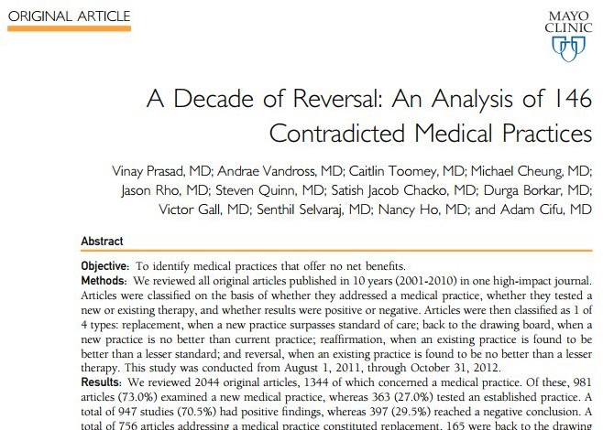
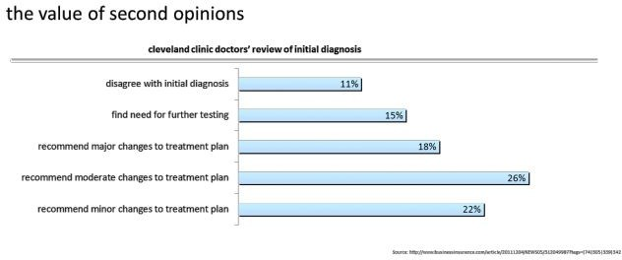
Experts disagree
Experts disagree among themselves.
E.g. oncology experts disagree on the value of colon screening
Things treated as facts for years end up being wrong.
E.g. giving aspirin to reduce fever has been proved to be dangerous
Psychiatric disorder diagnosis even lower agreement
(Cohen’s Kappa of 0.2 or 0.3 in most cases)

Slide 6
Growing complexity of knowledge
Very slow pace for doctors to acquire new knowledge
Increased amount of complexity
E.g. Coordinating specialists treating a patient is very complex and done using very little technology
No universally accepted processes and recommendations to make decisions.
Those depend on each institution and practitioner
50% of the recommendations made in guidelines based on expert opinion, case studies, or standards of care, not systematic studies

Slide 7
No personalization!
Clinical Practice Guides are not personalized
They might prove negative since they fail to take into account interactions between different diseases (e.g. in older patients)
Research done on “homogeneous”, healthy subjects
It is very hard for doctors to “manually” personalize their “recommendations”

Slide 8
What does this have to do with Recsys?

Slide 9
A word on Precision Medicine

Slide 10
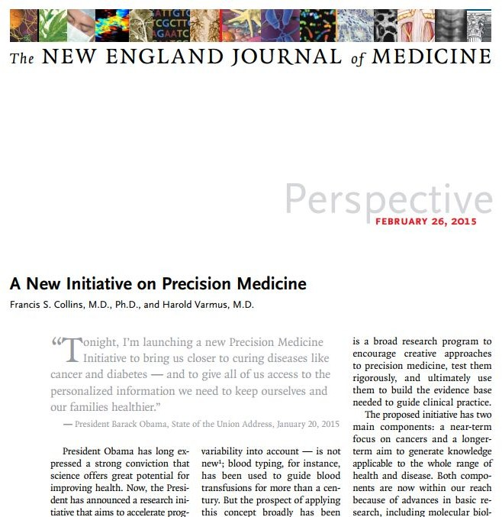
Precision medicine
According to the National Institutes of Health (NIH), precision medicine is:
"an emerging approach for disease treatment and prevention that takes into account individual variability in genes, environment, and lifestyle for each person."

Slide 11
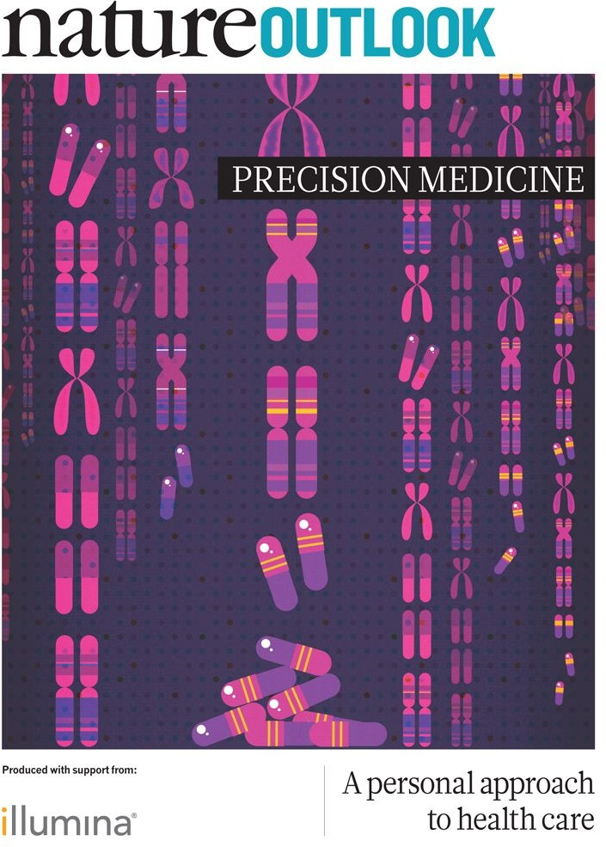
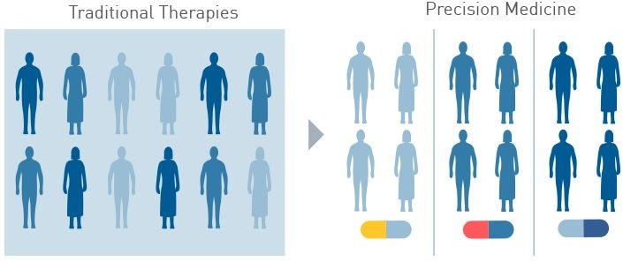
Precision medicine
Goal: predict more accurately treatment and prevention given a particular disease & group of people
In contrast to "one-size-fits-all" approach where treatment & prevention are developed for average person
Term is relatively new, but concept has been around for many years.
E.g. blood transfusion is not given from a randomly selected donor

Slide 12
Recsys & Medicine

Slide 13
Recommender System (Recsys)
Recommender systems aim to help users by providing suitable options to execute a task easily and efficiently.
Such systems learn user behavior by filtering through a large amount of data

Slide 14
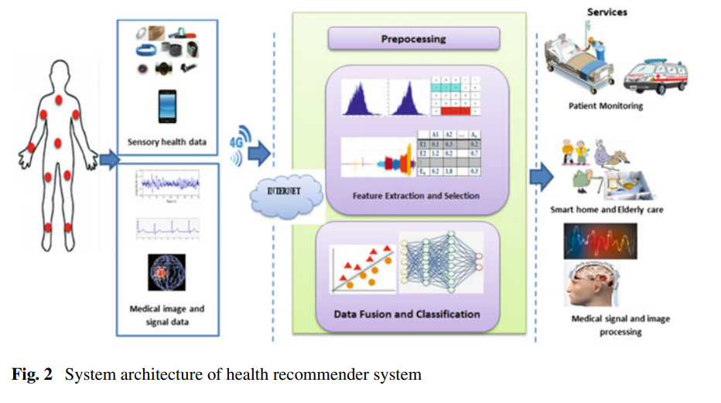
Recsys in Health Care

Slide 15
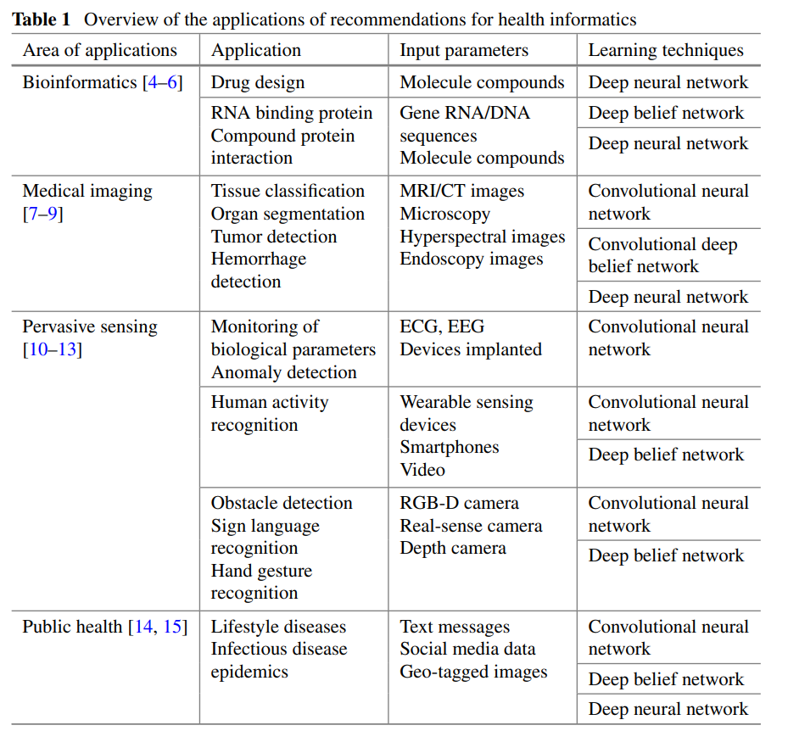

Slide 16
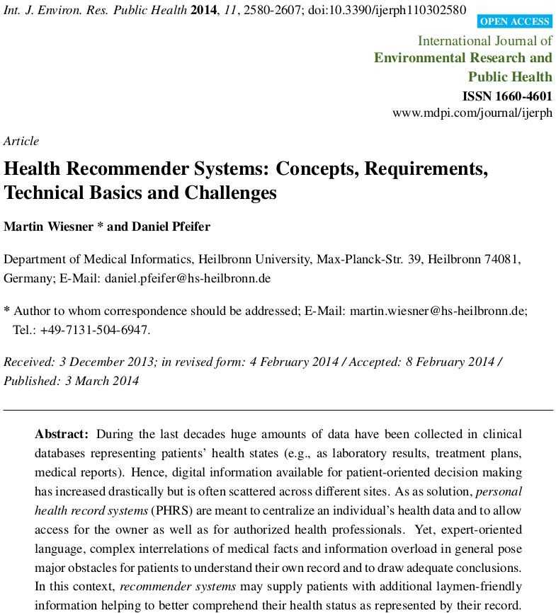
How to improve medicine?
More/better personalization
Make better use of (big) data
Automate processes through algorithms and machine learning
Better user experience both for patients and doctors
Does this sound familiar?

Slide 17
Medical Decision Support Systems

Slide 18
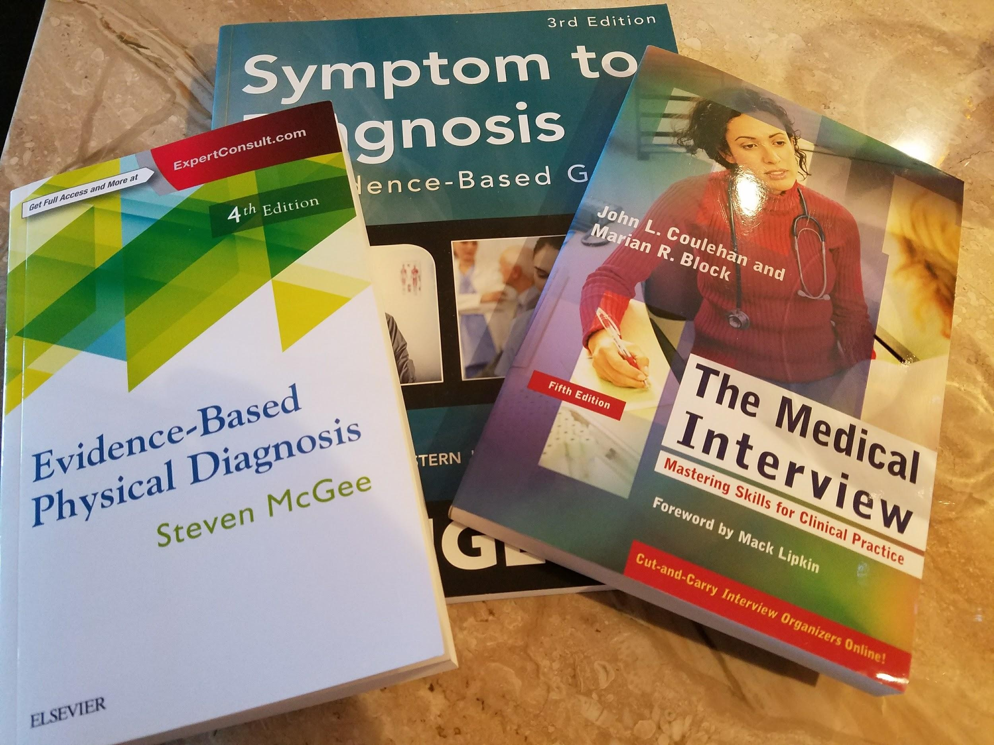
Medical Diagnosis
Diagnosis:
“a mapping from a patient’s data ( normal and abnormal history , physical examination , and laboratory data ) to a nosology of disease states the process of determining by examination the nature and circumstances of a diseased condition”
“The knowledge of how to “work up” the patient depends critically on the ability to evoke history, symptoms, and physical examination findings, concurrently with the ability to generate diagnostic hypotheses that suggest how to further refine or pursue the findings already elicited, or to pursue completely different additional findings. In addition, this must be done in a compassionate and cost-effective manner” (R.A. Miller 1990)

Slide 19
Diagnosis Decision Support Systems
DDSS
A computer - based algorithm that assists a clinician with one or more component steps of the diagnostic process
It involves diverse activities:
information gathering
pattern recognition
problem solving
Decision-making
judgment under uncertainty
Empathy
Large amounts of highly organized knowledge are necessary
Two categories
General-domain DDSS
Specialized DDSS

Slide 20
Medical Diagnosis as a Recsys
Input signals
Implicit: Data coming from sensors, labs…
Explicit: What does the patient tell us
Others: Demographic, family history…
Algorithms
Find what worked for “similar” patients in a “similar” situation
Output
Ranked list with “likely” options
Need to also worry about other variables such as acuity, explanations....

Slide 21
Knowledge-based approaches to medical decision systems

Slide 22

Decision/Diagnosis support systems
They have been developed for decades
Many early DDSS based on Bayesian reasoning (60s-70s)
Bayesian networks (80s-90s)
Neural networks (lately)
Most of them have been developed “manually” with doctors looking at research and manually encoding that into knowledge bases.

Slide 23
Data for Medical Decision Systems

Slide 24
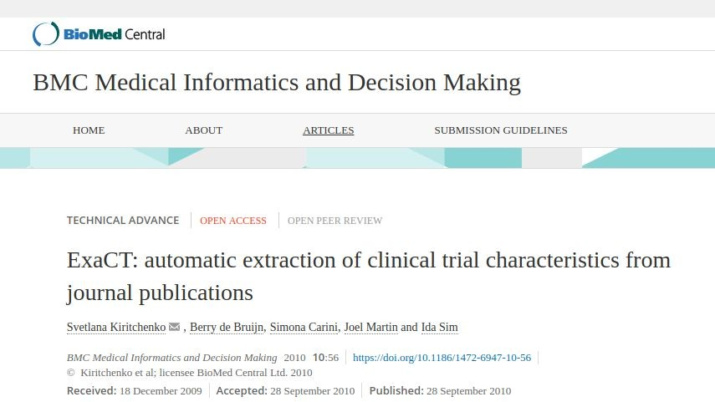
Knowledge bases
Knowledge base construction
Build model from existing medical knowledge
E.g. using doctors to read on medical literature and encode “well-established facts”
Data = Medical Research
Ingesting and understanding medical publications can be mostly automated

Slide 25
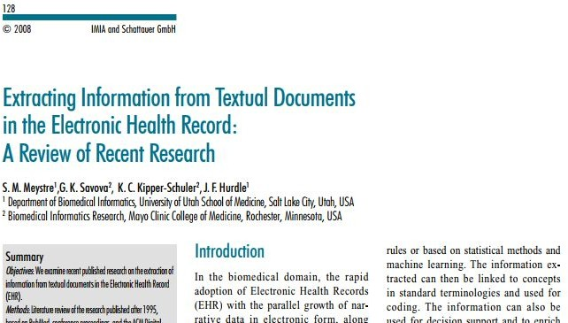
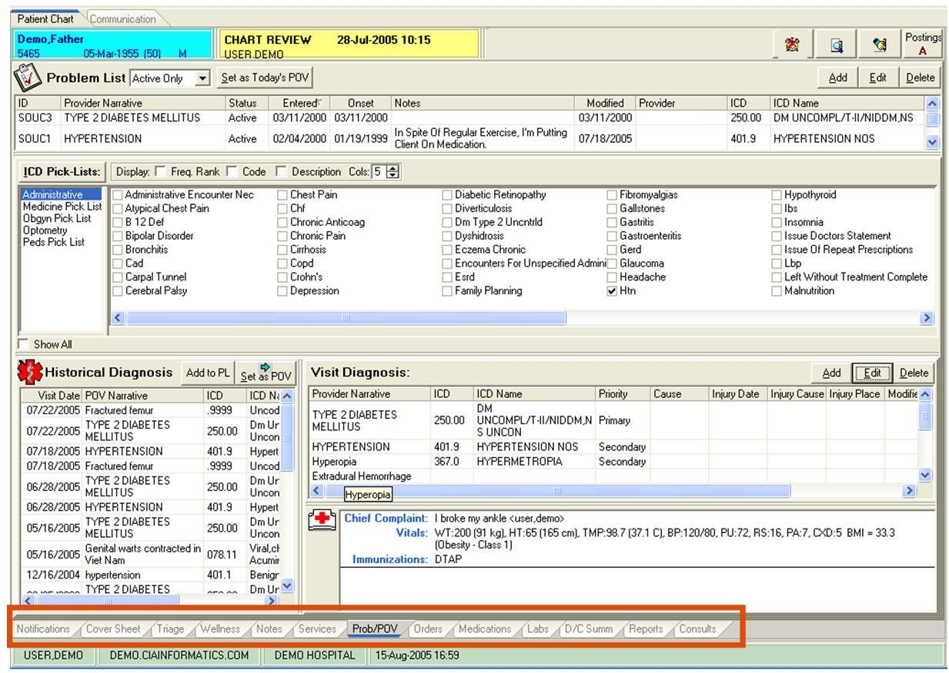
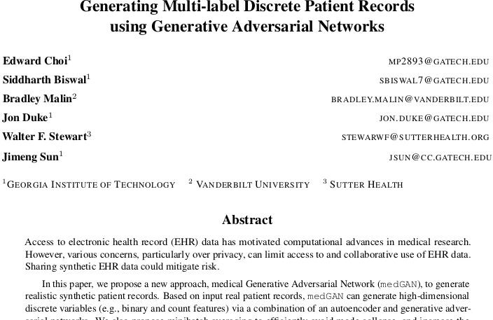
Electronic Health Records
EHR/EMRs include digital information about patients encounters with doctors or the health system

Slide 26

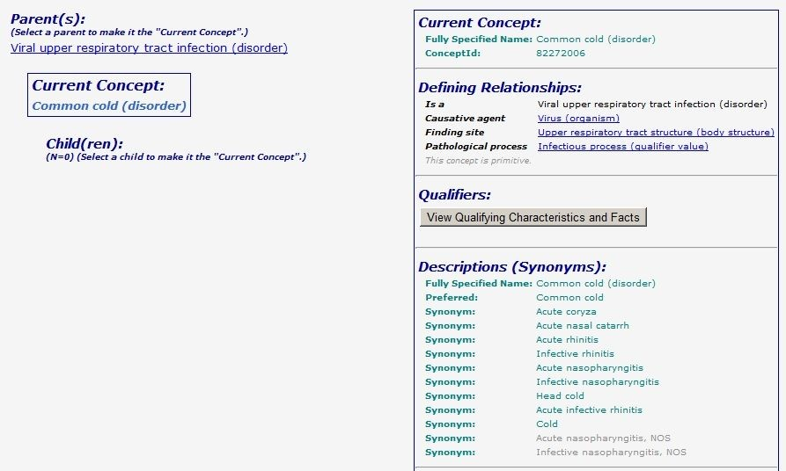
Ontologies
Snomed Clinical Terms
Computer processable collection of medical terms providing codes, terms, synonyms and definitions used in clinical documentation and reporting.
Considered to be the most comprehensive, multilingual clinical healthcare terminology
Primary purpose: encode the meanings that are used in health information & support effective clinical recording of data with the aim of improving patient care.
It provides the core general terminology for electronic health records.
It includes: clinical findings, symptoms, diagnoses, procedures, body structures, organisms and other etiologies, substances, pharmaceuticals, devices and specimens.

Slide 27
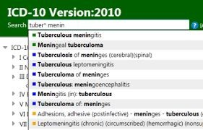
Ontologies
ICD-10
10th revision of the International Statistical Classification of Diseases and Related Health Problems (ICD), a medical classification list by the World Health Organization (WHO)
It contains codes for diseases, signs and symptoms, abnormal findings, complaints, social circumstances, and external causes of injury or diseases
The code set allows more than 14,400 different codes and permits the tracking of new diagnoses.

Slide 28

Ontologies
UMLS (1986)
Designed and is maintained by the US National Library of Medicine, updated quarterly, free
Compendium of many controlled vocabularies in the biomedical sciences.
Provides mapping structure among vocabularies
Allows to translate among the various terminology systems
It can be interpreted as a thesaurus and ontology of biomedical concepts.
It provides tools for natural language processing.
Intended for developers of systems in medical informatics.

Slide 29
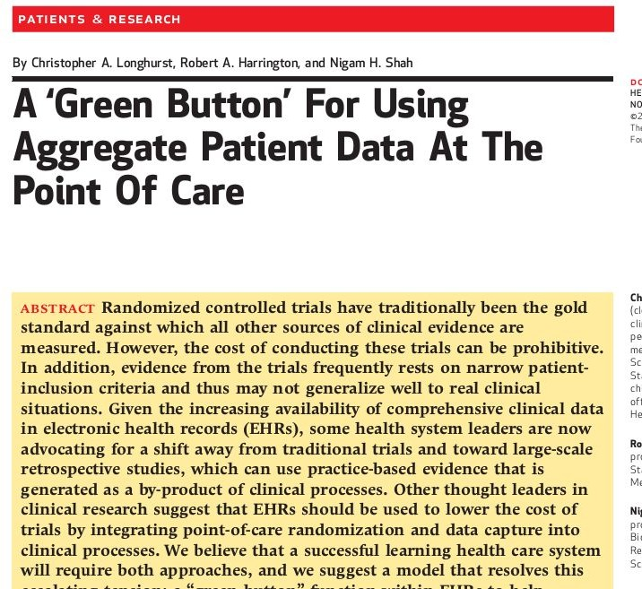
Combining and aggregating data
At the end, what you need is a way to process and aggregate all these different sources of data either manually (expert systems) or algorithmically (ML)

Slide 30
ML for Medical Decision Systems

Slide 31
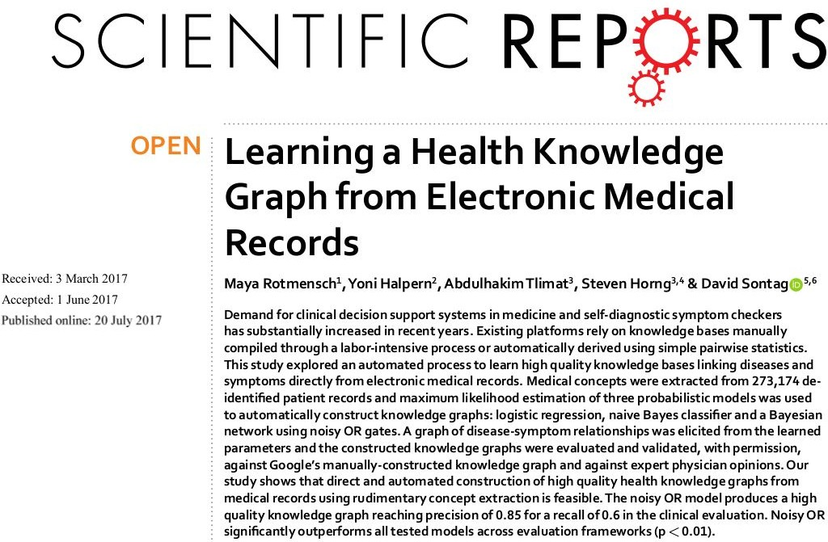
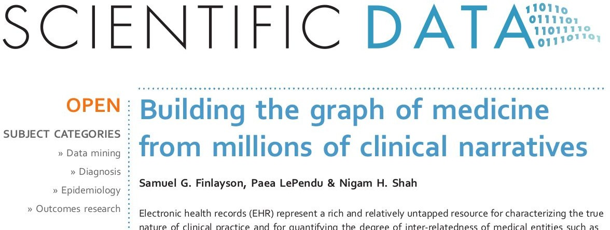
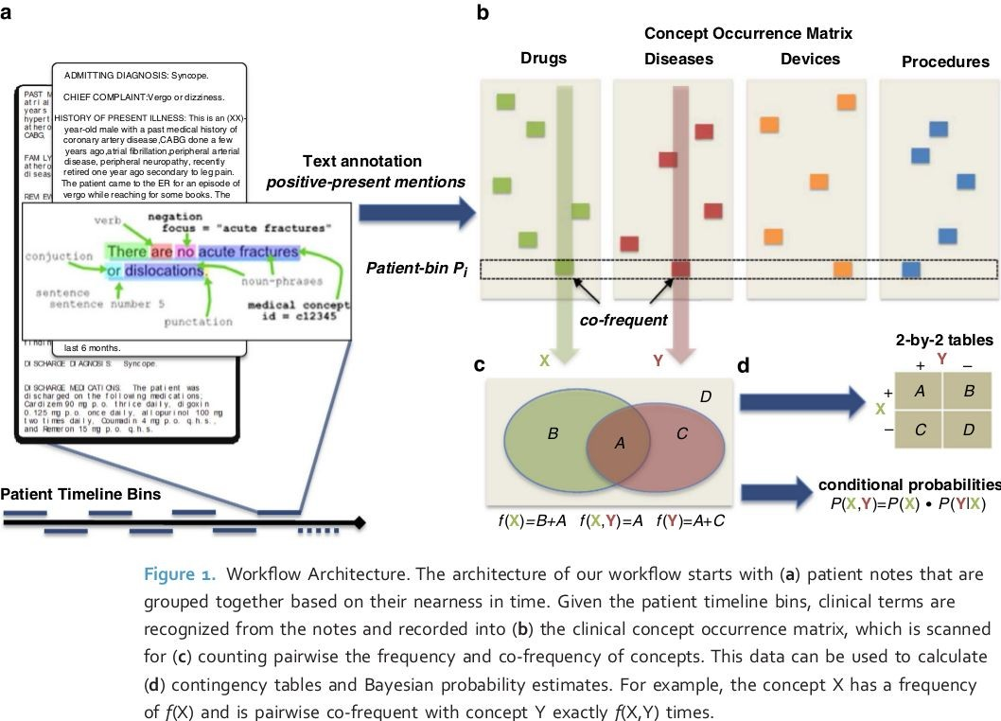
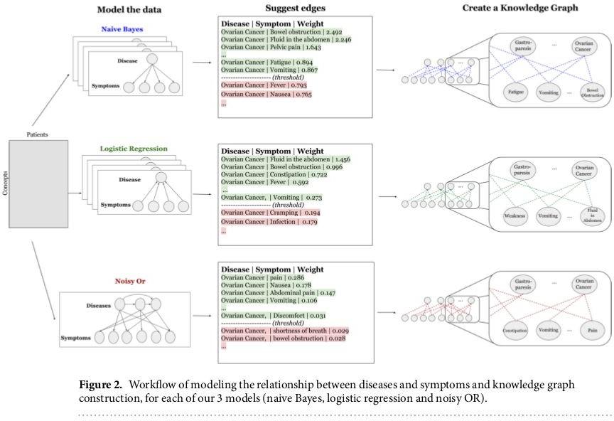
Health graphs

Slide 32
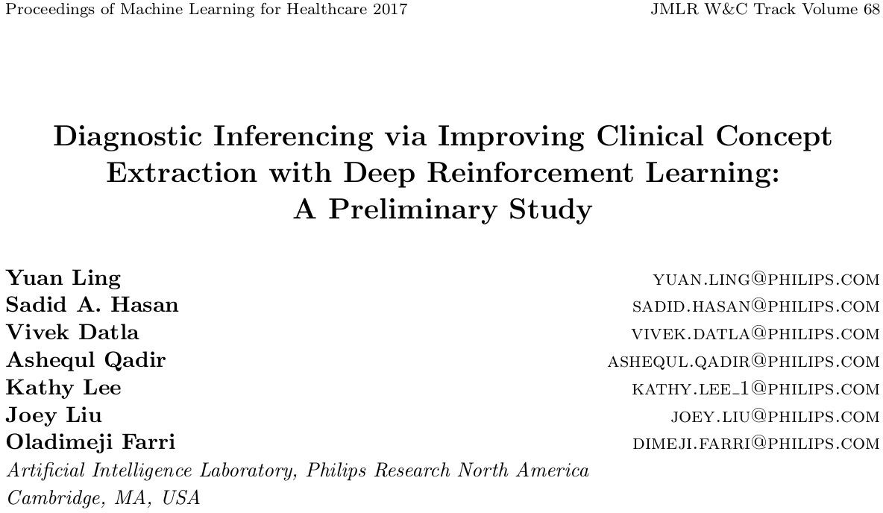
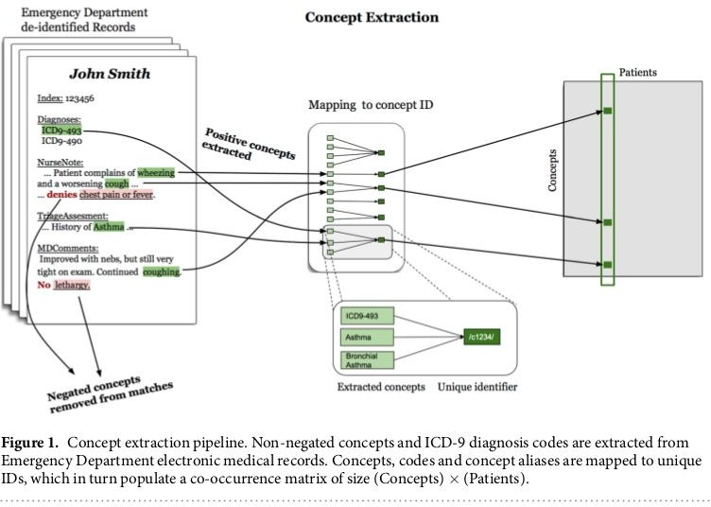
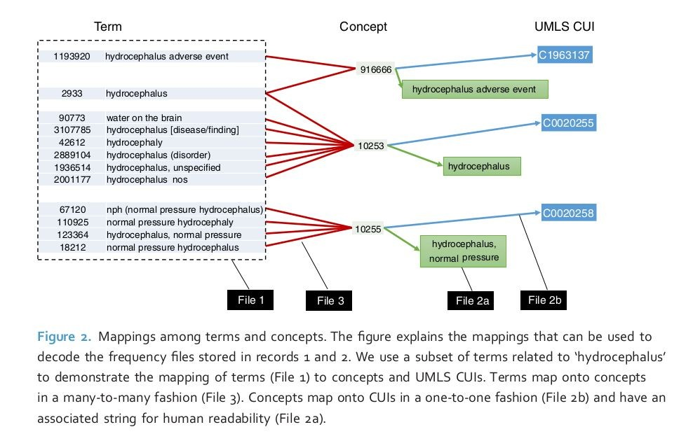
NLP
Understanding what doctors say
Understanding what patients say

Slide 33
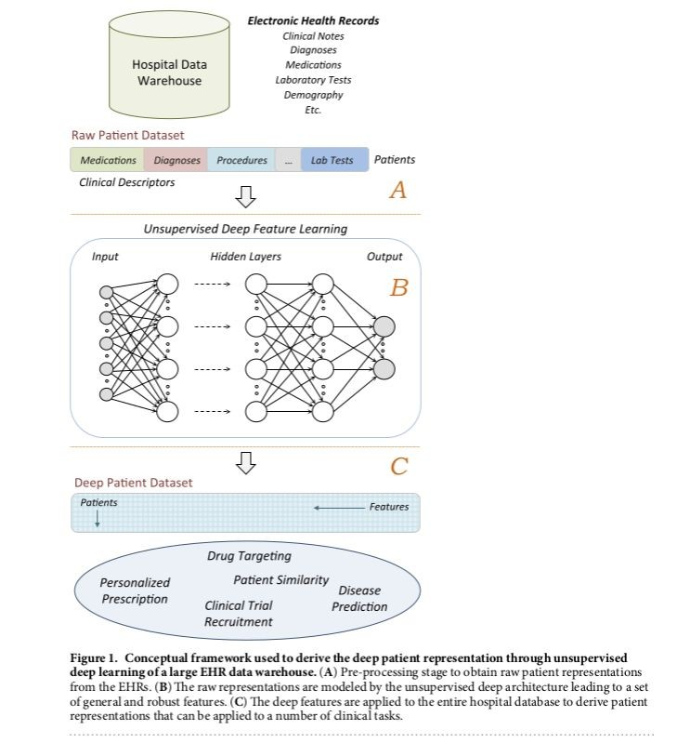
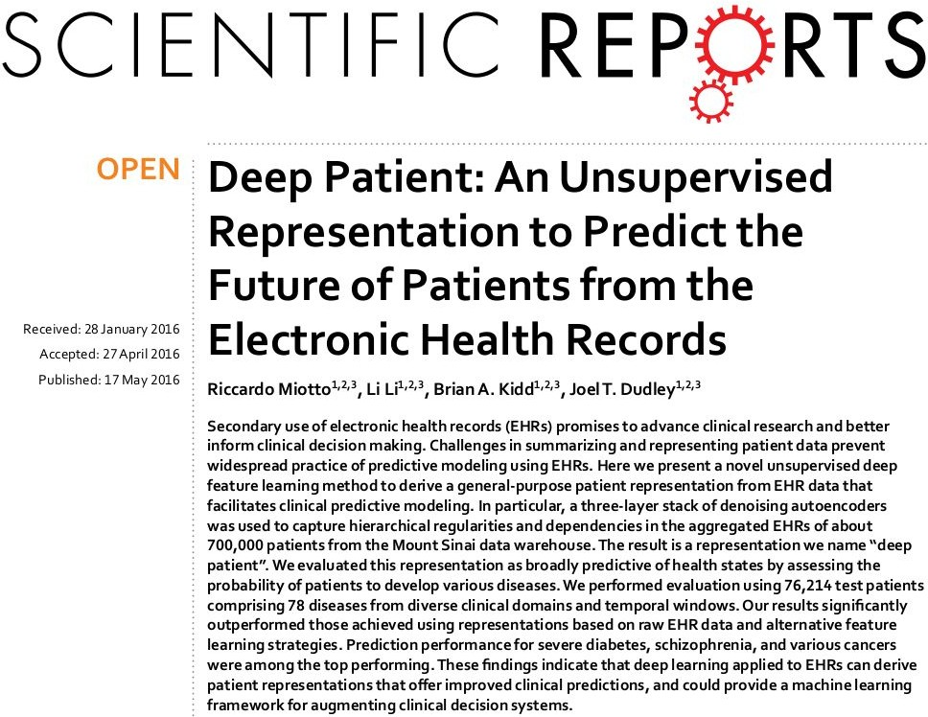
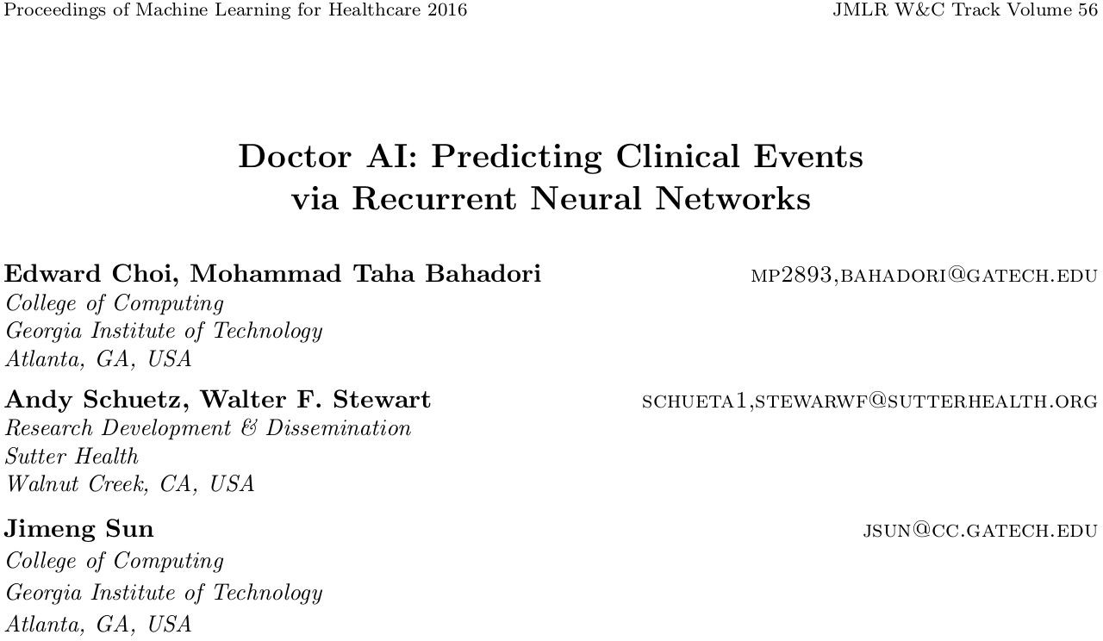
Diagnostic Systems
Building diagnostic systems from data through ML

Slide 34
Challenges
Algorithmic: e.g. combining expert rule-based and ML
Data: quality, sparsity, and bias in data
UX: trustworthiness and engagement of the system, incentives…
Legal
…
It’s about time we overcome all of these.

Slide 35
Conclusions
Medicine/healthcare is one of the areas in society that can benefit most from technology in general and algorithmic approaches in particular
Medicine has many similarities to recommender systems
Importance of data (both big and small)
Content and collaborative approaches
Importance of UI/UX (e.g. user understanding, feedback, and explanations)
Evaluation has to be sensitive to overall optimization problem
Huge opportunity, great mission: looking forward to many advances that will save millions of lives in the next few years

Slide 36
References
“Probabilistic diagnosis using a reformulation of the INTERNIST-1/QMR knowledge base” . Shwe et al. 1991.
“Computer-assisted diagnostic decision support: history, challenges, and possible paths forward” Miller. 2009.
“Mining Biomedical Ontologies and Data Using RDF Hypergraphs” Liu et al. 2013.
“Health Recommender Systems: Concepts, Requirements, Technical Basics & Challenges”, Wiesner & Pfeifer, 2014.
“A ‘Green Button’ For Using Aggregate Patient Data At The Point Of Care ” Longhurst et al. 2014.
“Building the graph of medicine from millions of clinical narratives” Finlayson et al. 2014.
“Comparison of Physician and Computer Diagnostic Accuracy” Semigran et al. 2016.
“Identifiable Phenotyping using Constrained Non-Negative Matrix Factorization”. Joshi et al. 2016.
“Clinical Tagging with Joint Probabilistic Models” . Halpern et al. 2016.
“Deep Patient: An Unsupervised Representation to Predict the Future of Patients from EHR ”. Miotto et al. 2016.
“Learning a Health Knowledge Graph from Electronic Medical Records” Rotmensch et al. 2017.
“Clustering Patients with Tensor Decomposition”. Ruffini et al. 2017.
“Patient Similarity Using Population Statistics and Multiple Kernel Learning ”. Conroy et al. 2017.
“Diagnostic Inferencing via Clinical Concept Extraction with Deep Reinforcement Learning”. Ling et al. 2017.
“Generating Multi-label Discrete Patient Records using Generative Adversarial Networks” Choi et al. 2017
Saha J., Chowdhury C., Biswas S. (2020) Review of Machine Learning and Deep Learning Based Recommender Systems for Health Informatics. In: Dash S., Acharya B., Mittal M., Abraham A., Kelemen A. (eds) Deep Learning Techniques for Biomedical and Health Informatics. Studies in Big Data, vol 68. Springer, Cham. https://doi.org/10.1007/978-3-030-33966-1_6

